Slide 1
Notes : Creational Patterns
As told by the GoF

Slide 2
Intro

Slide 3
What problem do creational patterns solve ?
Creational design patterns make a system “independent of how its objects are created, composed and represented”.
HOW ?
By encapsulating knowledge about the concrete classes the system uses
By hiding the way instances of these classes are created and put together

Slide 4
List of creational patterns
Singleton
Factory Method
Prototype
Abstract Factory
Builder

Slide 5
Singleton
Intent :
ensure there is at most a single instance of a class at any given time
provide access to the instance from any point in the program
Applicability :
There must be a single, globally accessible instance of a class
The instance’s class should be extensible

Slide 6
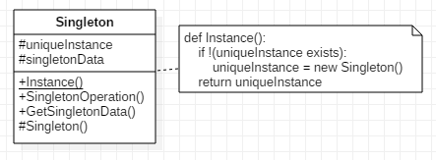
Singleton

Slide 7
Singleton
Consequences :
Controlled access to sole instance thanks to encapsulation
Avoid global variables
Extensibility means that the client can use an instance of the singleton’s subclass
Easily extensible to provide several possible instances
Avoids having static (“class”) functions

Slide 8
Singleton
Implementation details :
The method Instance() returning the unique instance can be implemented as static and test for the existence of the instance.
The class should also have a static uniqueInstance attribute
The constructor and the uniqueInstance should be private to avoid multiple object instantiation
When sub-classing Singleton, choose the subclass to instantiate within the Instance() method or by using a registry of singletons. (Other possibilities exist, see GoF’s Singleton for details)

Slide 9
Factory Method
Intent :
Applicability :

Slide 10
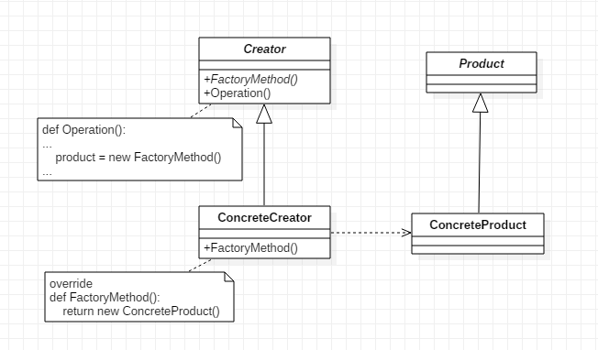
Factory Method

Slide 11
Factory Method
Consequences :

Slide 12
Factory Method
Implementation details :

Slide 13
Prototype
Intent :
Applicability :

Slide 14
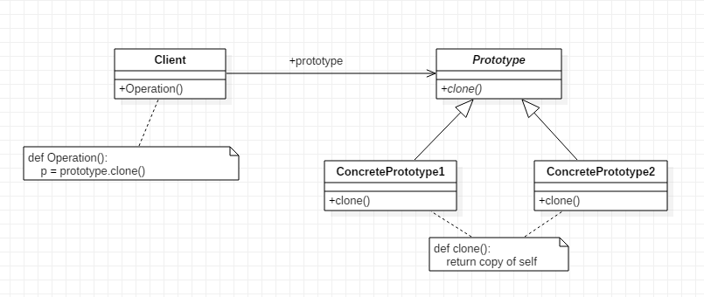
Prototype

Slide 15
Prototype
Consequences :

Slide 16
Prototype
Implementation details :

Slide 17
Abstract Factory
Intent :
Applicability :

Slide 18
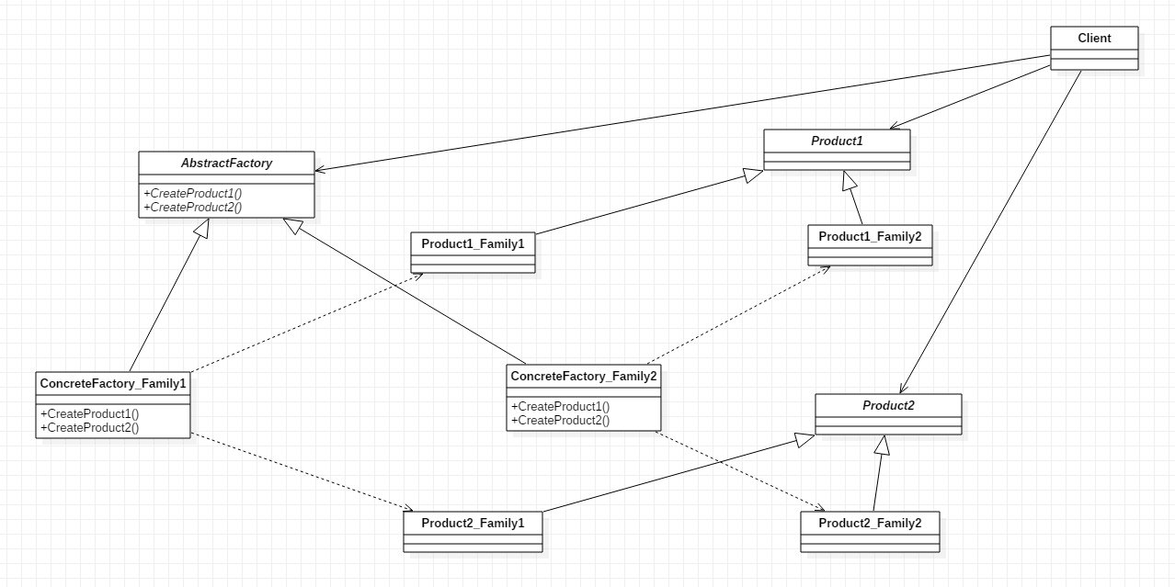
Abstract Factory

Slide 19
Abstract Factory
Consequences :

Slide 20
Abstract Factory
Implementation details :

Slide 21
Builder
Intent :
Applicability :

Slide 22
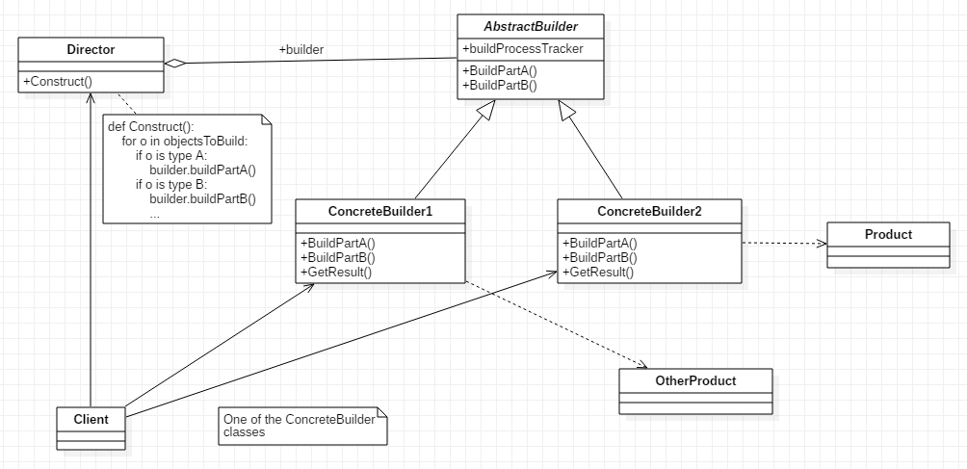
Builder

Slide 23
Builder
Consequences :

Slide 24
Builder
Implementation details :

Slide 25
Creational Patterns
Conclusion :

